Slide 1
Workplace Health & Safety
Assessment 1 - Game Art
Benjamin Scott
DUE DATE:

Slide 2
Introduction
Introduction:
This assessment will examine the process of writing a WHS management plan for a fictional game studio, in line with the provided scenario. The provided brief is designed to collect all the evidence of competency you require for this subject. Following an alternative brief and/or presenting additional evidence of competency needs to be negotiated with your teacher.
The assessment will include:
Analysing a scenario.
Identifying WHS responsibilities.
Conducting hazard and risk assessments.
Implementing WHS control measures.
Evaluating control measures.
Planning WHS Training.
Observing and maintaining healthy work practices.
The assessment instructions:
All sections marked in green must be edited/filled out by each student. Be sure to replace “Student Name” on the first slide and include your name in the document filename.

Slide 3
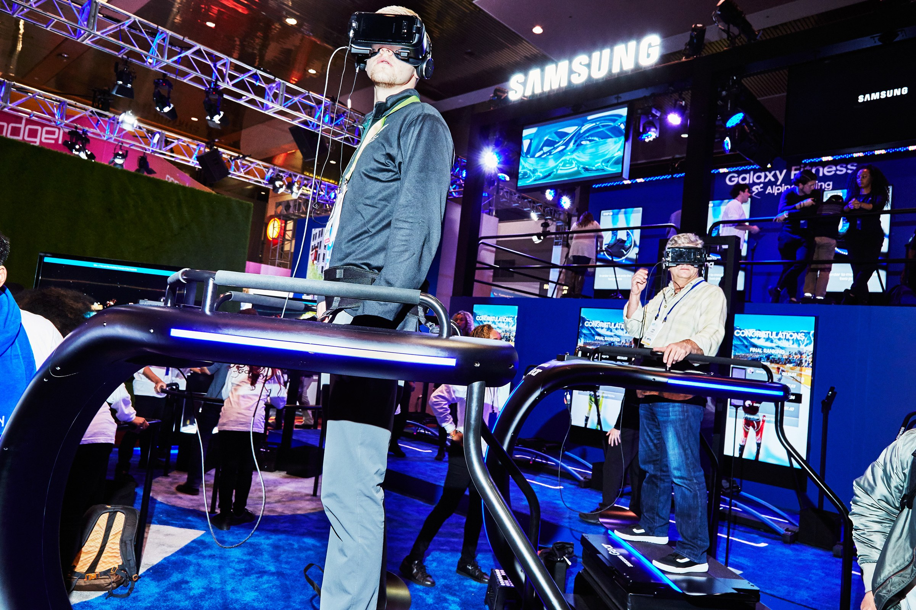
Scenario|VR Game Demo
Overview:
You are the manager of a small studio “IntenseVR Games” who have been invited to demonstrate your new multiplayer Virtual Reality game demo at the GamesRock convention.
Your game is a full VR competitive multiplayer, fast paced action, sci-fi, horror game which allows the player to use melee attacks as well as jump, duck and dodge.
It is 48 hours until showtime and there are still a lot of bugs to sort out back at the studio and your team will need as much time as they can get to fix them all.
The booth needs to be delivered and set up 12 hours before the doors open, this will
Involve the studio manager taking a team of 3-4 to construct the heavy framework
for the booth and setup all the equipment, which includes:
4 PC’s.
4 60inch OLED Display screens.
Overhead lights.
Sound system.
4 VR play areas.
The game will be periodically demonstrated by outsourced promotion company models in high action competitive matches as well as non-competitive sessions for the general public to play.
The all ages event runs until 10pm, pack down is to be completed by midnight.
There will be food and drink at the venue and areas must be kept clean at all times.

Slide 4
Health & Safety|Hazard list
As part of a class discussion, list any potential hazards which could arise in the provided scenario.
Mechanical: Loose wires can be a trip hazard. When the team has to set up all the equipment and heavy framework they need to make sure everything is fully functional like the pallet jacks and other machinery to assist in the heavy framework. making sure all equipment is properly installed. Not trying to move heavy framework without mechanical assistance. Picking up a heavily load incorrectly and lastly making sure not to leave and tools out because it can be a trip hazard.
Physical:the overhead lights that were setup could fall on someone causing Physical damage to them, Another Physical hazard would be when giving the player the ability to melee attack in game they have a chance of actually swing their arm and hitting the person next to them. They do have VR play areas so making sure only 1 person is in them will prevent this. People with heart issues playing a VR Horror game have a high risk of having heart issues. Another is eyesore, because your eyes are so close to the screen in VR this causes eye strain. Make sure each player doesn’t play for to long. Having 60 inch OLED display screen can create eye strain if the brightness it to high, the screen isn’t tilted correctly and isn’t to close to people.
Chemical: the cleaners could leave their equipment out because they may have forgotten them. if knocked over it could spill on someone. Another example would be someone's spilt a drink and the cleaners is using harsh chemicals like bleach etc it could spill on someone or the ground meaning if people are near by they could start to have trouble breathing from the smell in the air. When setting up the booth they could have painted it. The fresh paint could give off a vapour.
Psychological: the team members would have a lot of stress trying to beat the deadline while still having many bugs to fix. If they don’t meet the deadline they could be bullied and or left with the lack of satisfaction for the job that they did. They could also be left with no recognition for the hard work they did. Testing the game out over and over to make sure it works could leave to repetitive work. Having strobing lights could cause seizers so Letting people know there will be flashing in the game to prevent people with epilepsy from hurting themselves.
Electrical: Food and drink is allowed in the convention so there is a great risk of someone spilling their drink on anything electrical including the pc’s and VR gear. This could create a spark causing a fire hazard. Another electrical hazard would be malfunction, any wires or electrical components could create an electrical fire. Putting a device that heats up and putting it near something flammable and ignoring it could cause the flammable item to burn. Having a booth means limited power outlets making sure not to overload them will prevent the risk of an electric shock.

Slide 5
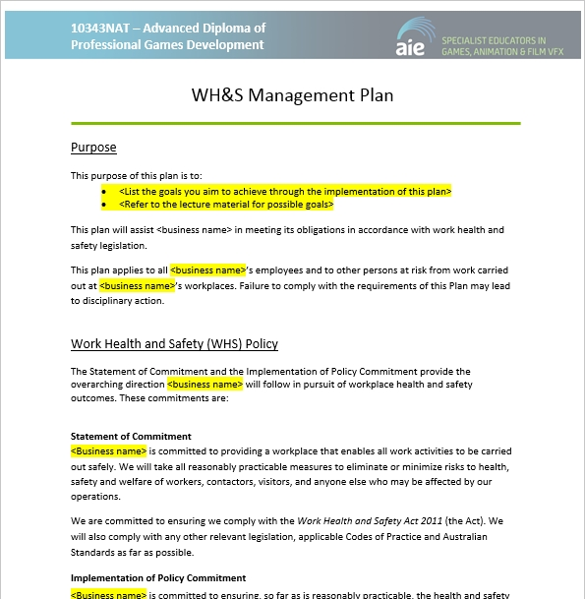
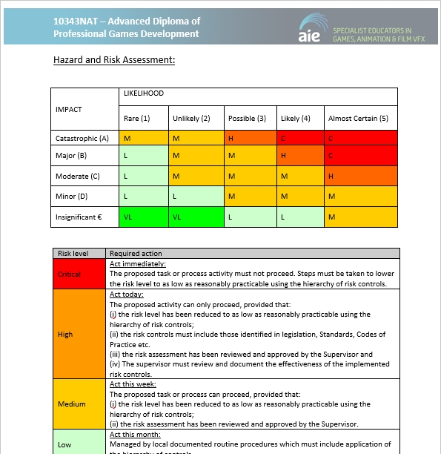
Health & Safety|WHS Management Plan
Utilising the above scenario complete all sections of the provided WHS management plan.

Slide 6
Workplace Health & Safety|Submission
The following files must be uploaded to Canvas for assessment. All submitted files must adhere to the provided naming conventions.
WHS Management Plan:
The WHS Management plan
BenjaminScott_HealthAndSafety_WHSManagementPlan.doc
Workbook:
The assessment workbook.
2021_HealthAndSafety_ BenjaminScott.pptx

